Slide 1
Windows Subsystem for Linux (WSL)

Slide 2
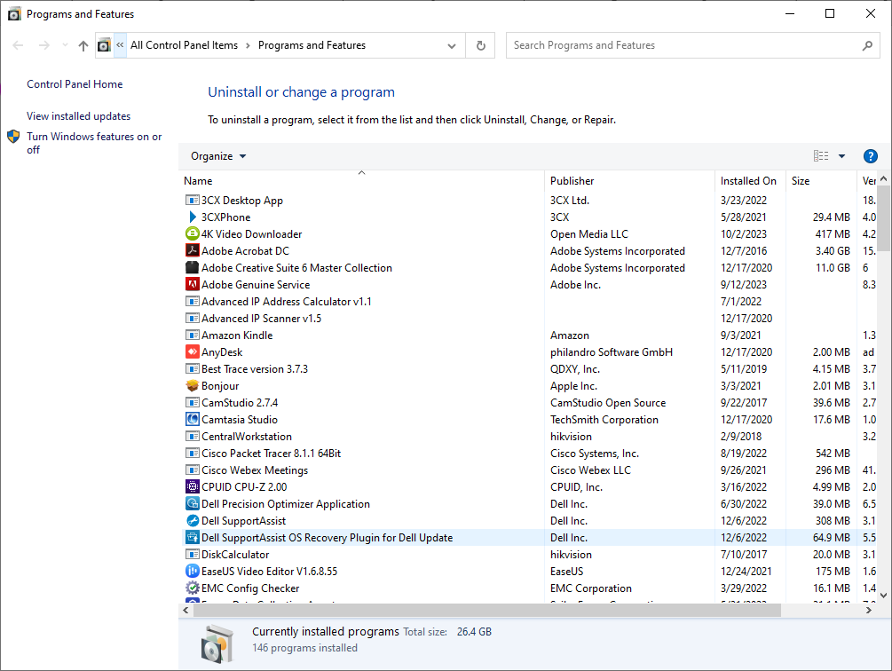
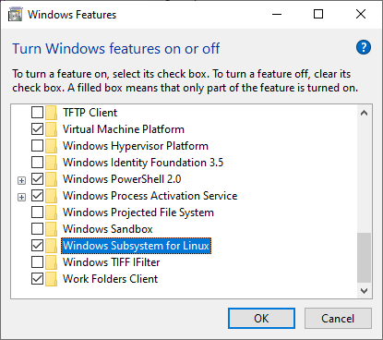
WSL – Install on Windows 10

Slide 3
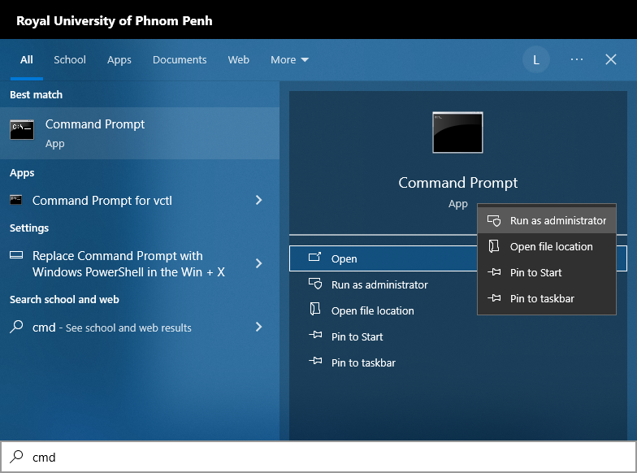
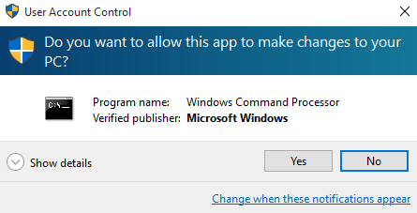
WSL – Start Cmd as Administrator

Slide 4
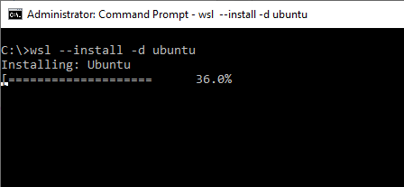
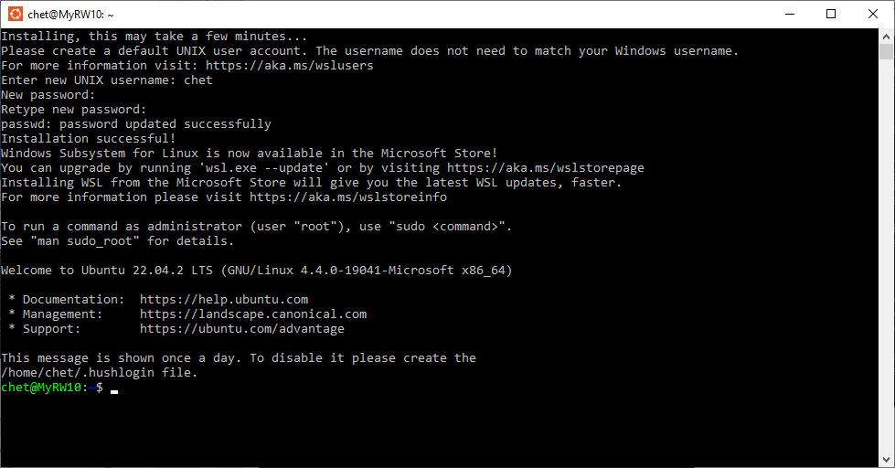
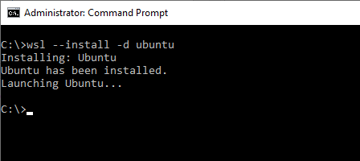
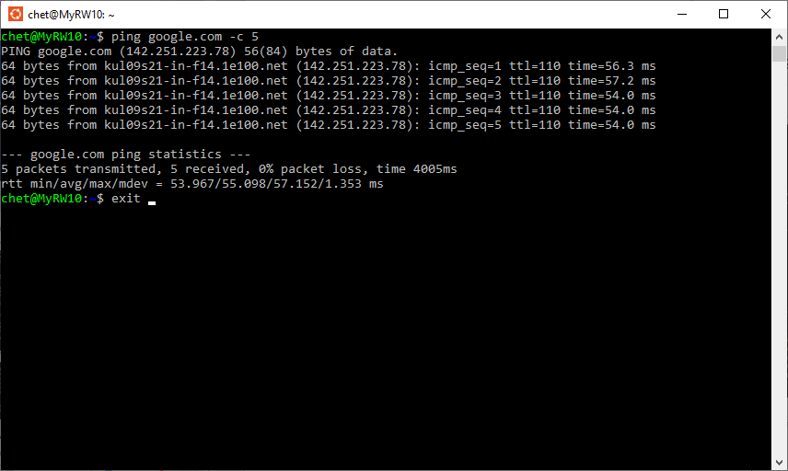
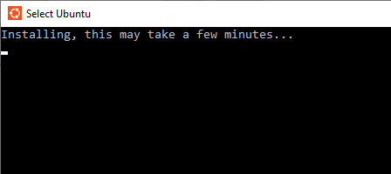
WSL – Install Ubuntu Distro

Slide 5
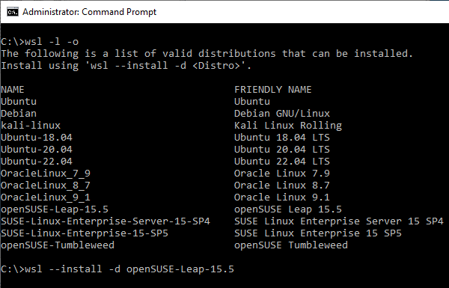
WSL – Install Additional Distros

Slide 6
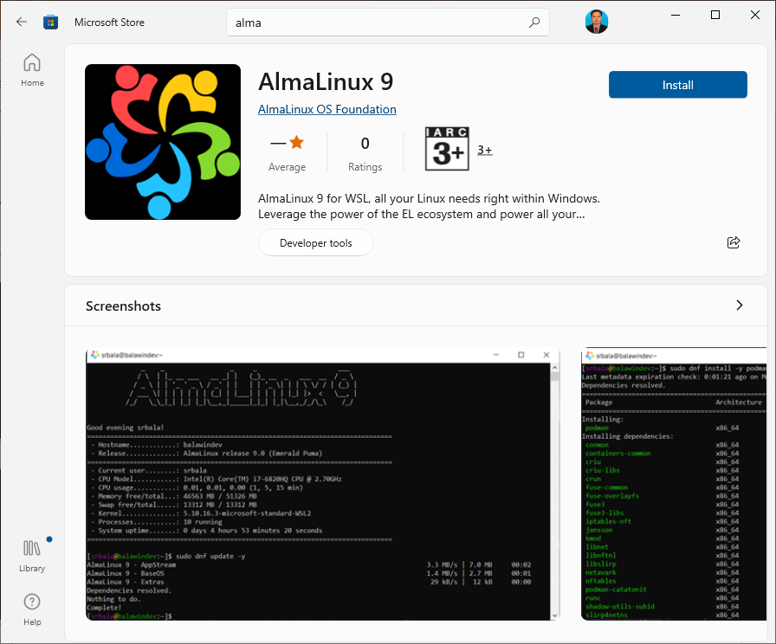
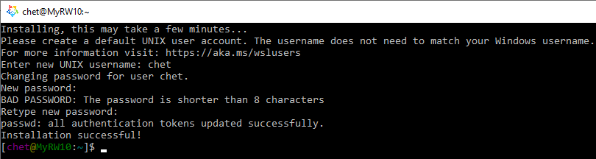
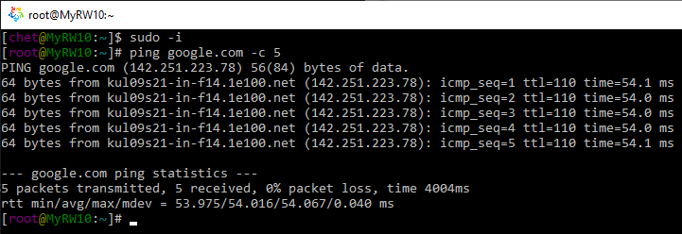
WSL – Install Additional Distros From MS Store
# yum install iptuils net-tools iproute bind-utils traceroute
...
# ifconfig
...
# ip route show
...
# host google.com
...
# traceroute google.com
...

Slide 7
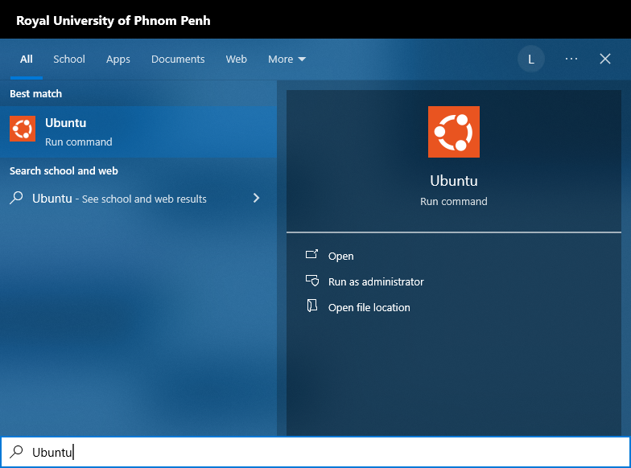
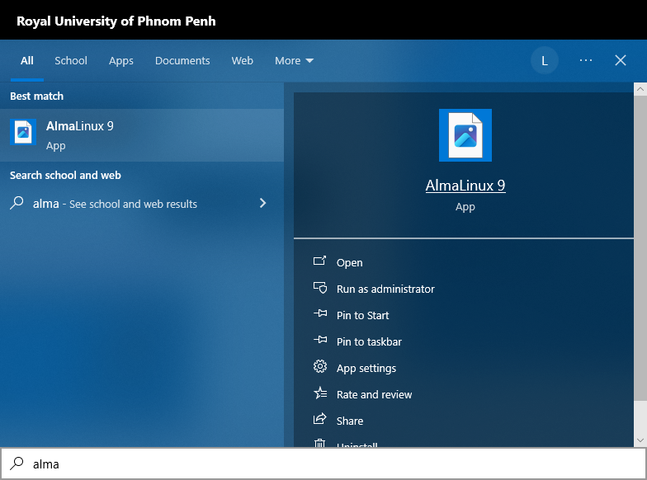
WSL – Running Installed Distros

Slide 8
WSL – Shutdown/Terminate a Running Distro
C:\>wsl -l -v
NAME STATE VERSION
* Ubuntu Stopped 1
AlmaLinux9 Stopped 1
C:\> wsl --help
C:\> wsl--shutdown
(Shutdown/terminate all running distros)
C:\> wsl -t Ubuntu
(Shutdown/terminate Ubuntu distro)

Slide 9
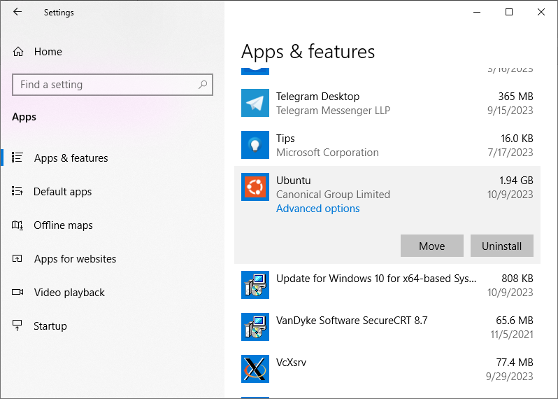
WSL – Uninstall a Distro
Step-1: shutdown and unregister the distro:
Step-2: Uninstall the distro from Apps & Features
C:\> wsl -t Ubuntu
(Shutdown/terminate Ubuntu distro)
C:\> wsl --unregister Ubuntu

